Slide 1
LIBRARY MANAGEMENT SYSTEM
Team Members: Komal(2310992042)
Madhu(2310992056)
Mehak(2310992067)
Diksha Vadehra(2310992592)
Faculty Coordinator: Shubham Chaudhary
Chitkara University Institute of Engineering and Technology, Chitkara University, Punjab

Slide 2



Table of Contents
Introduction
Problem Statement
Technical Details
System Architecture Design
Key Features
Project Highlights
Conclusion

Slide 3
Introduction
The Library Management System is a full-stack web application designed to digitize library operations.
It eliminates manual record-keeping and paper-based processes.
The system provides a centralized platform to manage books, students, and library activities.
Developed using modern web technologies to ensure efficiency and scalability.
Supports both public access and secured dashboards.
Designed for educational institutions and academic libraries.

Slide 4
Problem Statement
Traditional libraries rely on manual registers and spreadsheets.
Manual systems are prone to data loss and human errors.
Managing a large number of books and students is time-consuming.
Lack of proper access control causes data inconsistency.
Bulk student registration is difficult with manual methods.
Deployment and maintenance become complex without standardization.

Slide 5
Technical Details
Frontend Technologies: React.js for UI development,HTML, CSS, JavaScript for structure and styling
Backend Technologies: Node.js for server-side execution
Express.js for API development
Database: MongoDB for flexible and scalable data storage
Security: JWT for authentication,bcrypt for password encryption
Deployment: Docker for containerized deployment

Slide 6
System Architecture Design
The system follows a three-tier architecture.
Presentation Layer
Handles user interaction and UI rendering.
Application Layer
Processes business logic and API requests.
Data Layer
Manages data storage and retrieval.
RESTful APIs enable communication between frontend and backend.
Middleware ensures secure access to protected routes.
Docker ensures consistency across environments.

Slide 7
Key Features
Public pages to view available books.
Secure login for Admin and Students.
Admin dashboard functionalities:
  Add, edit, and delete books
  Add and delete student members
  Bulk student addition using Excel upload
Student dashboard functionalities:
  View available books
  Access personal dashboard
Secure role-based access control.

Slide 8
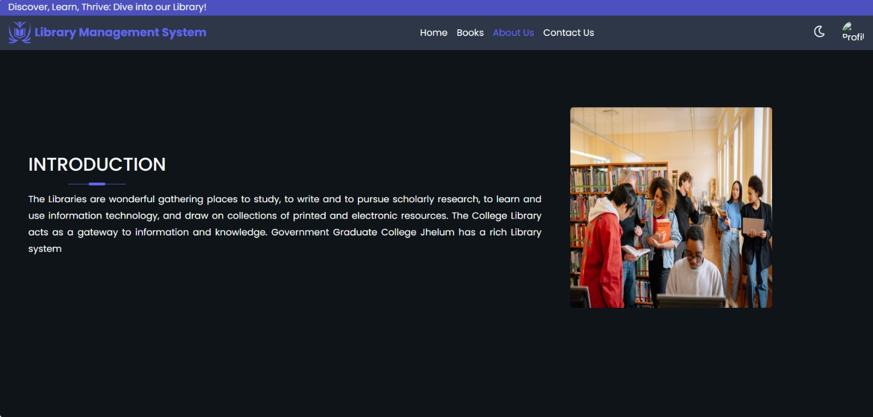
Project Highlights

Slide 9
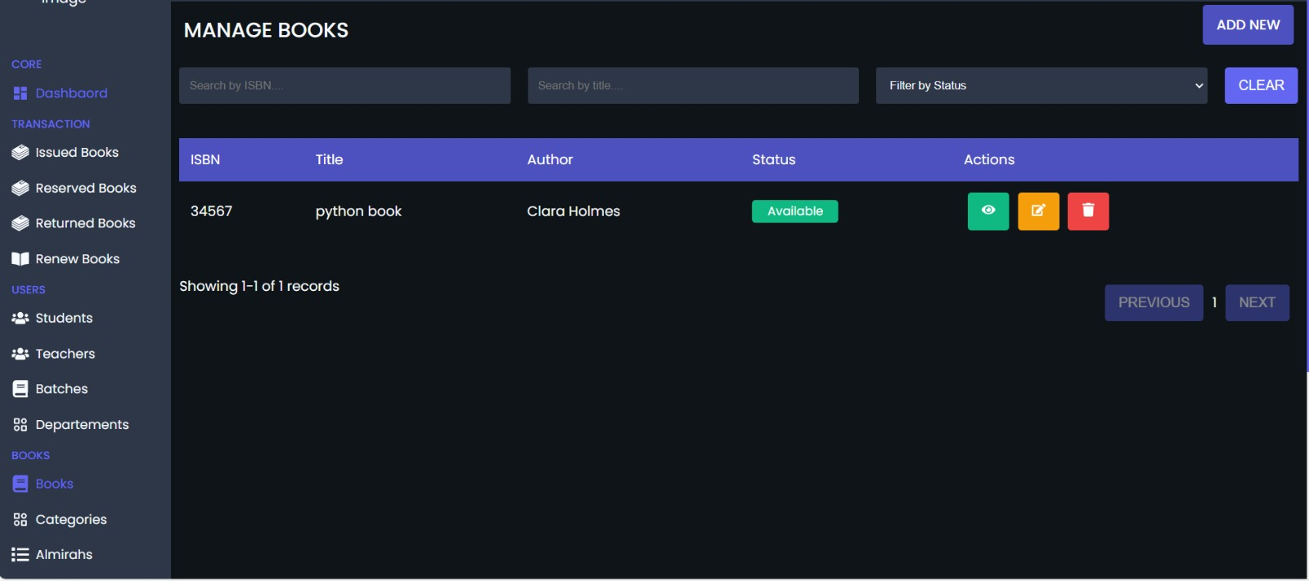
Project Highlights

Slide 10
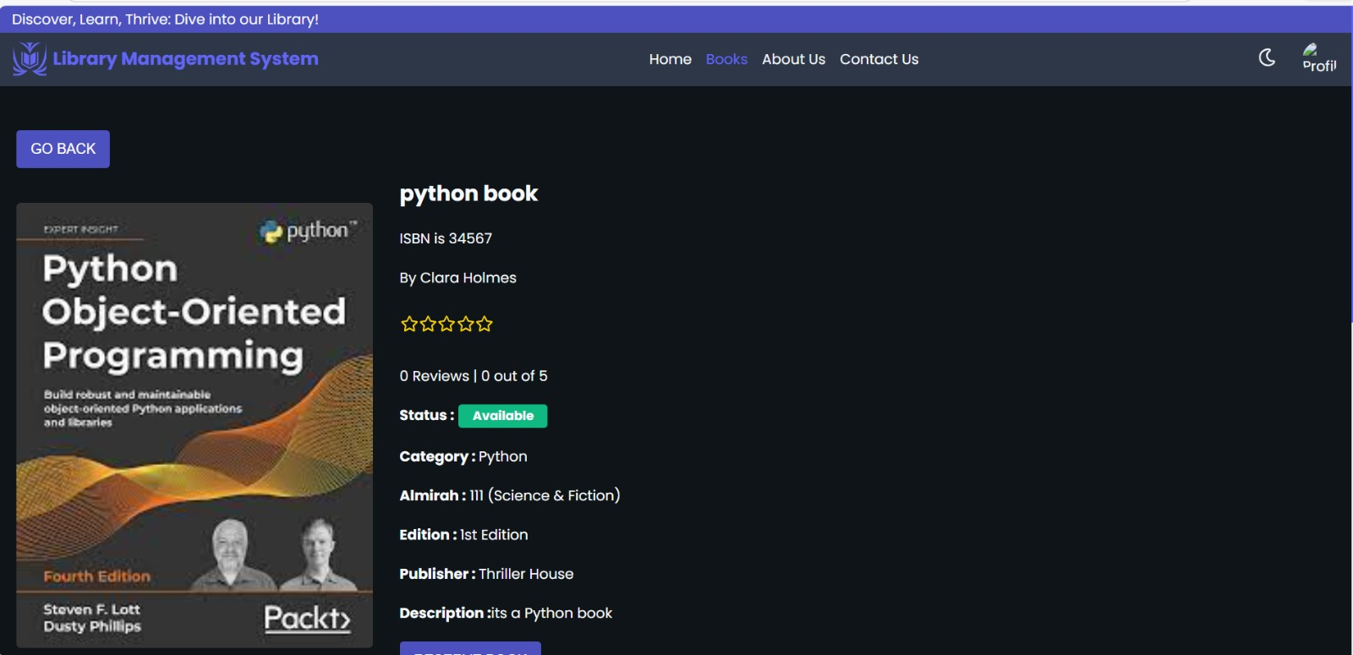
Project Highlights

Slide 11
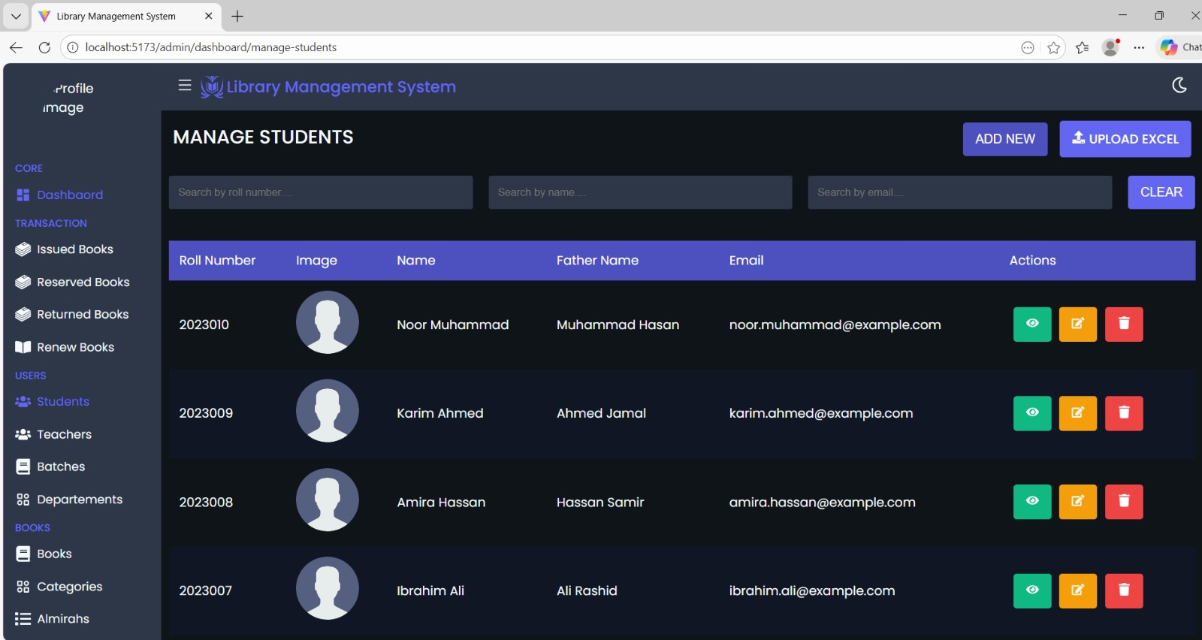
Project Highlights

Slide 12
Conclusion
The Library Management System improves efficiency and accuracy.
Reduces manual workload and operational errors.
Provides secure and controlled access to users.
Demonstrates strong full-stack development skills.
Easily extendable with advanced features such as:
Book issue/return tracking
Reports and analytics
Cloud deployment

Slide 13




